Slide 1
Sirius Project Status
2017-05-16

Slide 2
Sirius project plan and status
Project preparation is start from 2016/6 and done by 2016/12 and official start on 2016/12.
Build up whole chip Database, integrate all digital/Analog IP into SOC system
Build up whole chip SOC RTL simulation environment to verify design function.
Build up whole chip Veloce emulate environment to verify design function and user case, develop software firmware and system solution.
Release Bronze/Silver/Pre-gold RTL & NETLIST & SDC.
Project now is coming into #2 trial run stage with VSI (3rd party design service company), build whole chip floor plan, sub-block floor-plan, clean SDC/netlist/UPF issue, run place&route timing check.

Slide 3
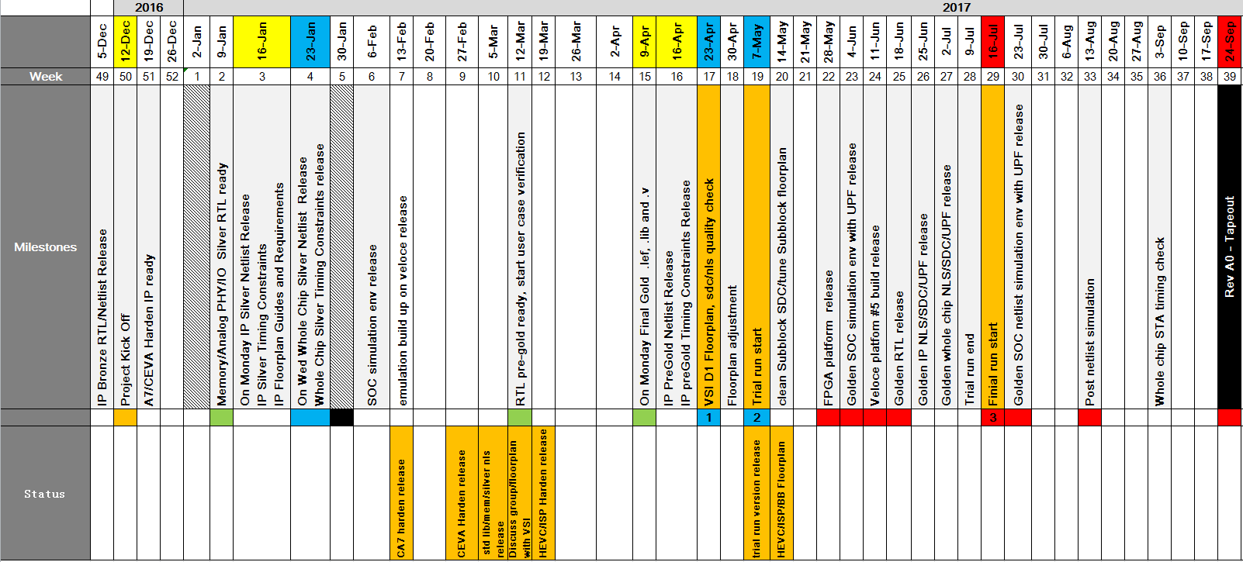
Sirius project schedule

Slide 4
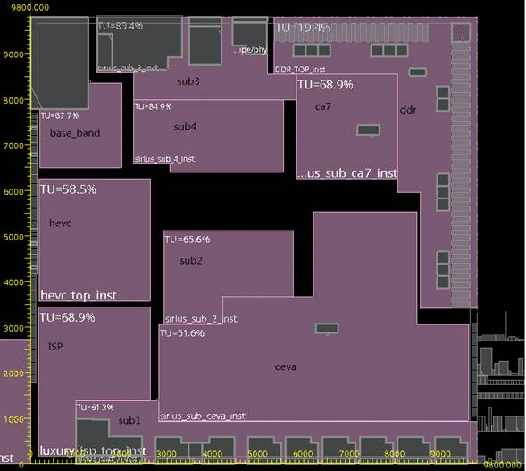
Sirius whole chip floor plan

Slide 5
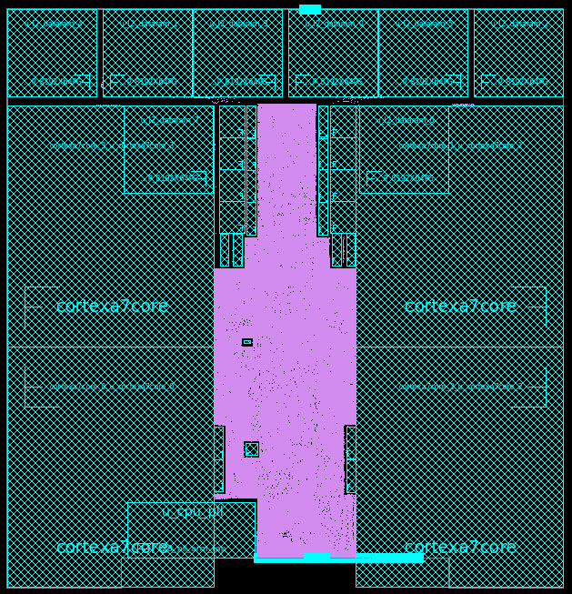
Sirius CA7 CPU 4xCore diagram

Slide 6
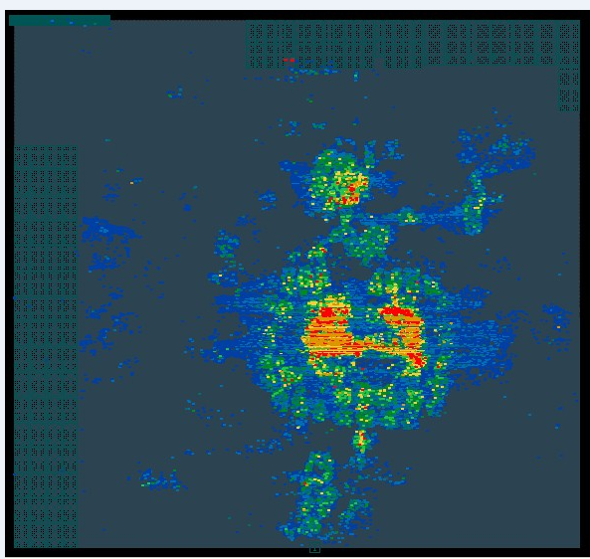
Sirius CEVA DSP 1xCore diagram

Slide 7
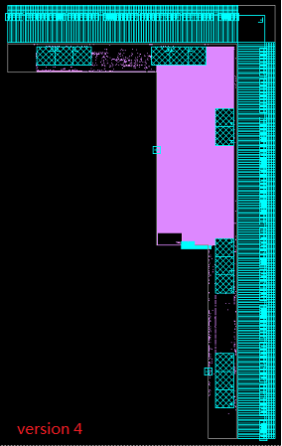
Sirius DDR4 block diagram

Slide 8
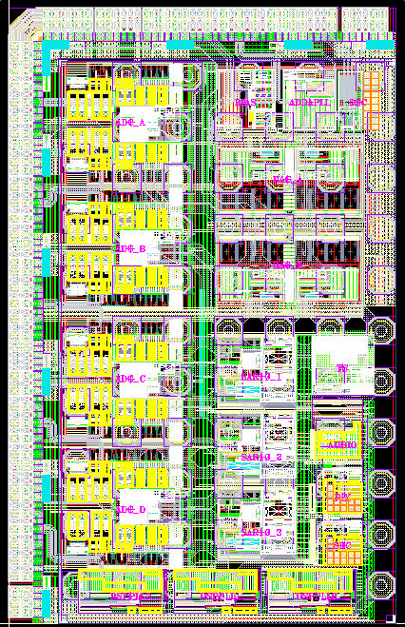
Sirius ABB analog block diagram

